Slide 1

Effect of Covid-19 on New York City Transportation (March 2020 – June 2020)
By: Michael Reichard, Yeonjae Riyoon, Joshua Sohan, Anumala Thapa

Slide 2
Table of Contents
Ridership
Taxi & For-Hire Vehicles
Citibike
Subway
Questions

Slide 3
Taxi & For-Hire Vehicles Usage

Slide 4
Taxi and For-hire Vehicles:
Data sources:
https://github.com/nychealth/coronavirus-data
https://www1.nyc.gov/site/tlc/about/tlc-trip-record-data.page
Focal Point:
Case count from coronavirus data
Pick-up datetime from trip record data
Consideration:
Yellow Taxi, Green Taxi and For-hire Vehicles(i.e community based liveries, black cars and luxury limousines)

Slide 5
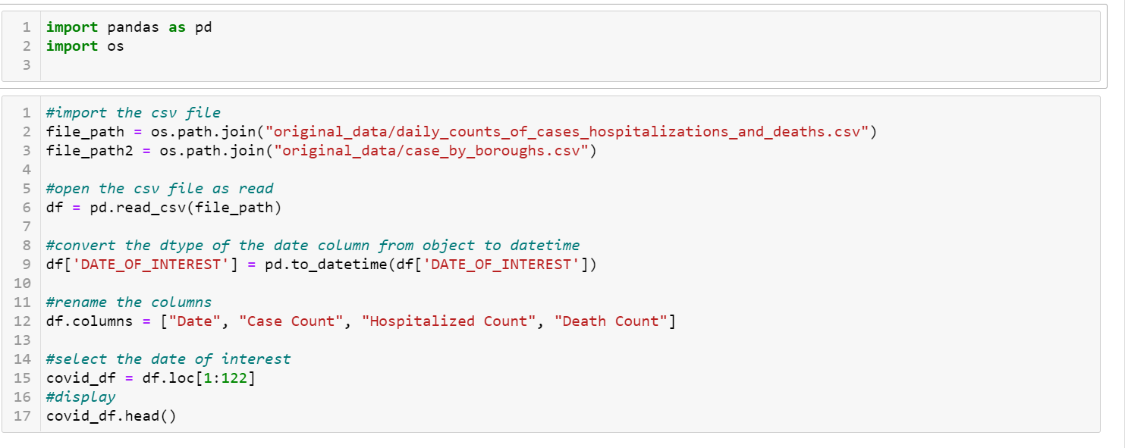
Covid-19 Data

Slide 6
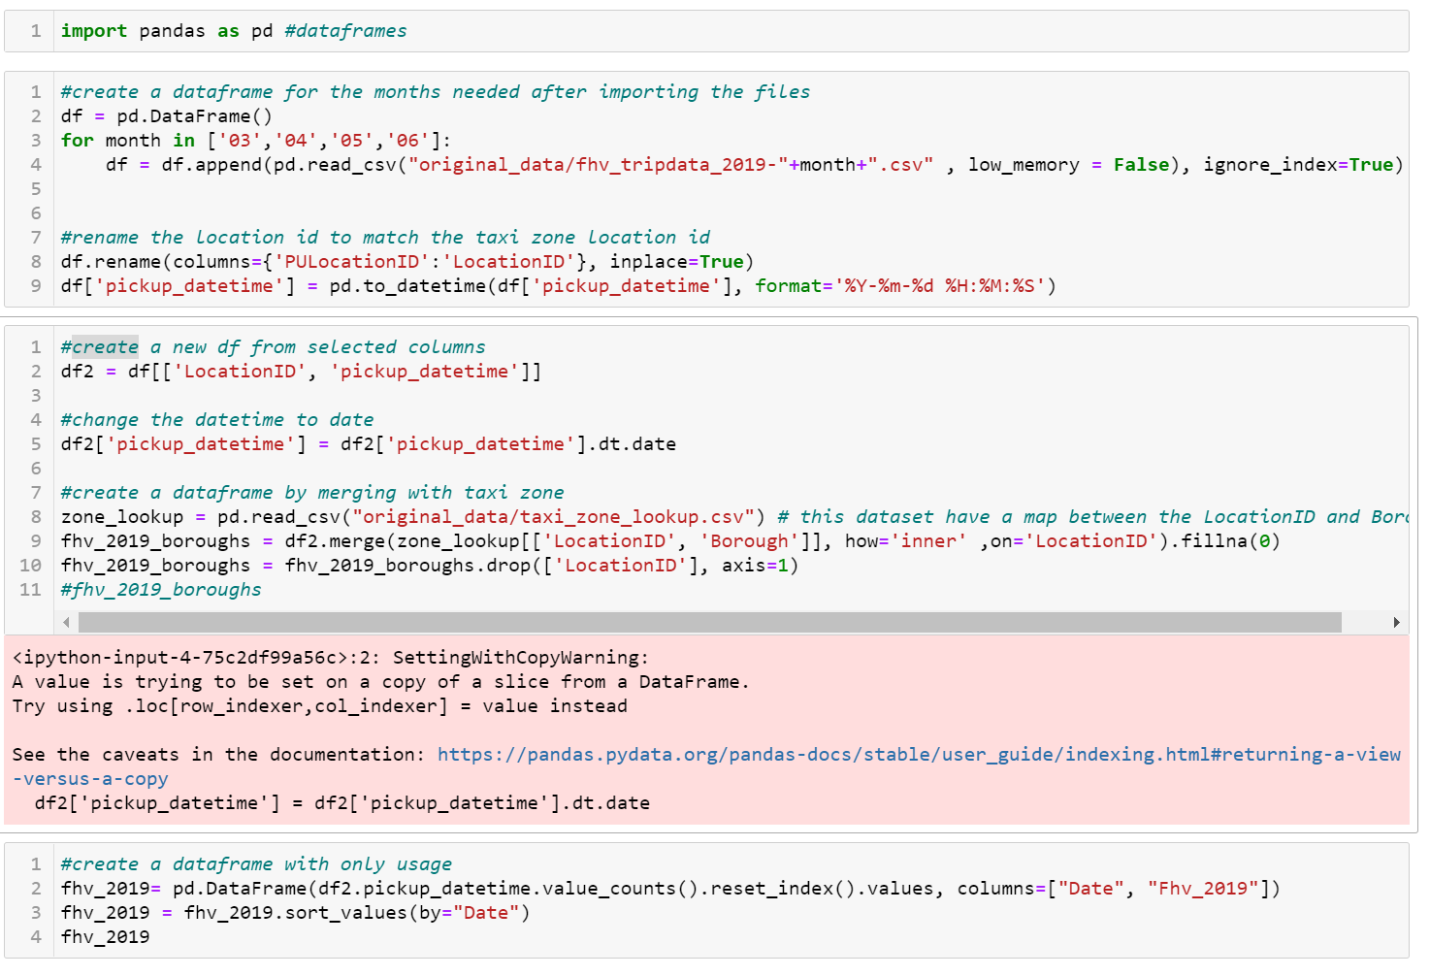
Taxi & FHV: Cleaning the Data

Slide 7
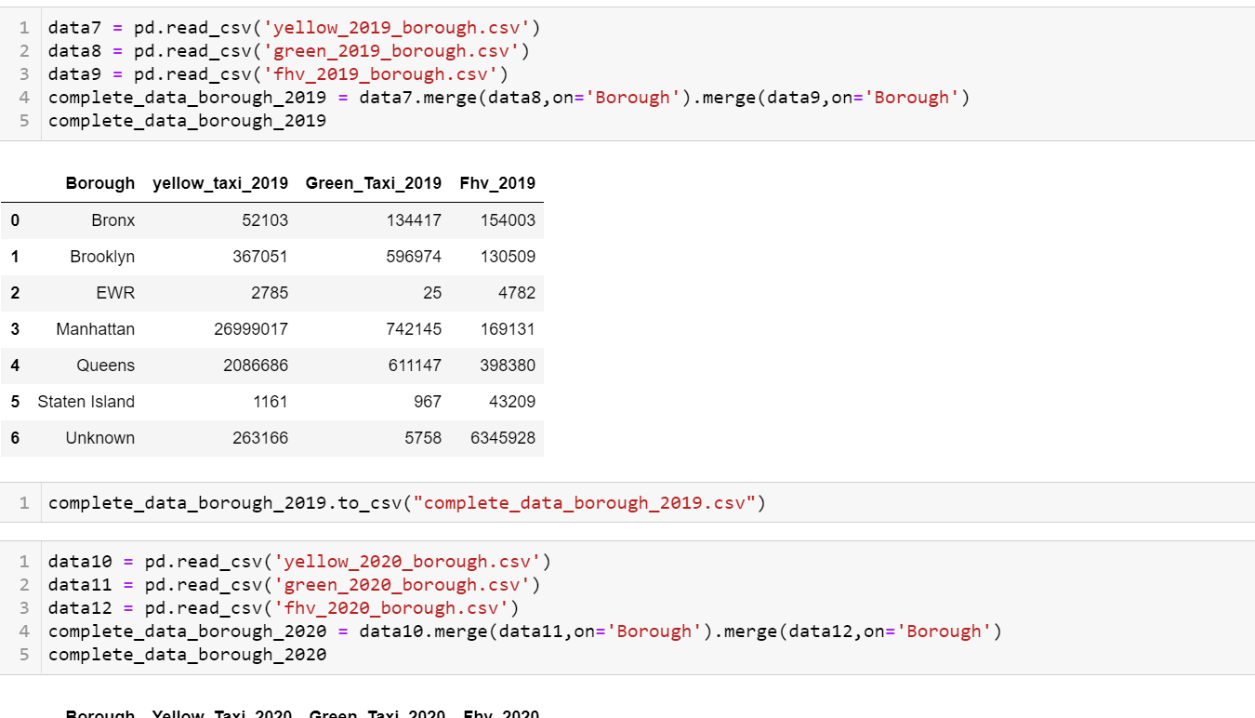
Taxi & FHV: Cleaning the Data

Slide 8
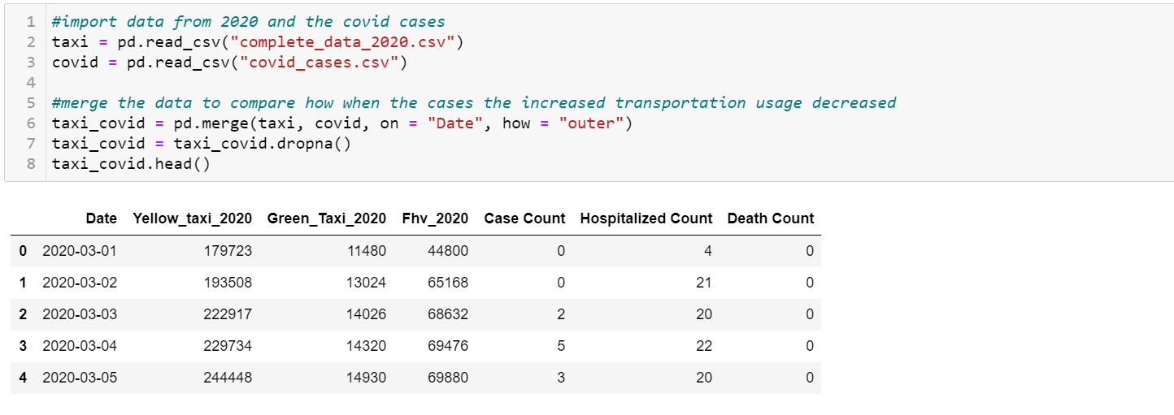
Taxi & FHV: Cleaning the Data

Slide 9
Taxi vs Covid:
March 20:
Lockdown
Case count: 4007
June 8:
Phase 1
Case count: 451
Usage went down during lockdown and started picking up slowly
Yellow cabs took the hit the most

Slide 10
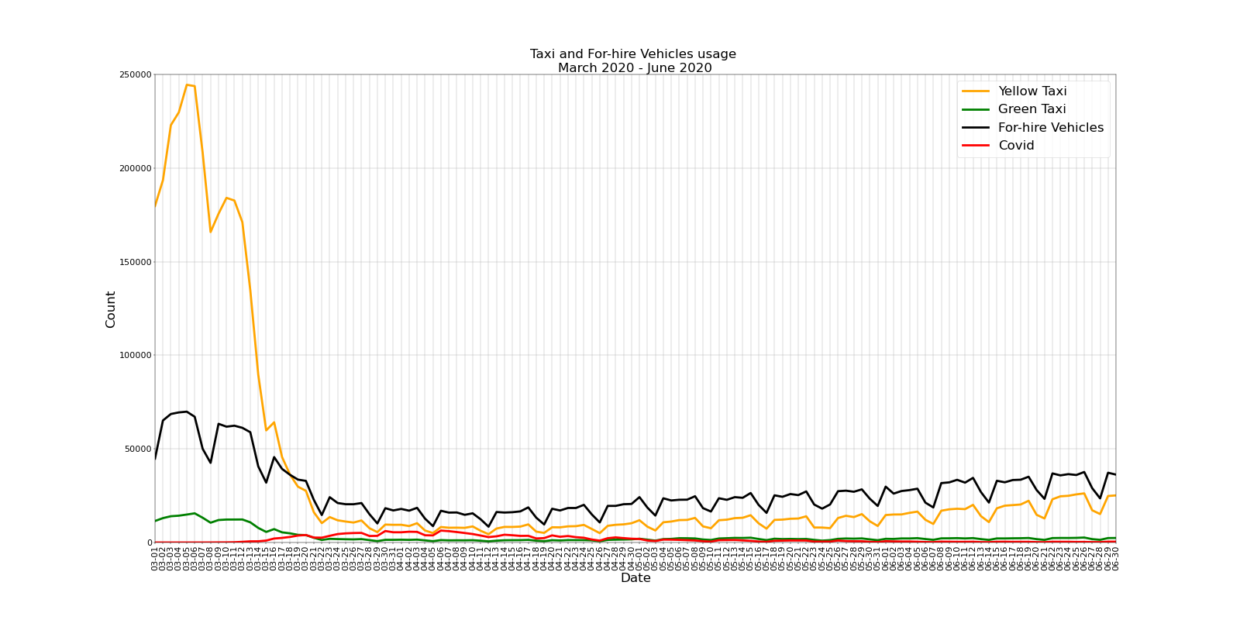

Slide 11
2019 vs 2020:
Compared to last year of March to June:
Yellow cabs decreased by almost 86%
Green cabs decreased by 81%
For-hire vehicles by 54%
(fyi: only 1 in 4 yellow cabs are in operation)

Slide 12
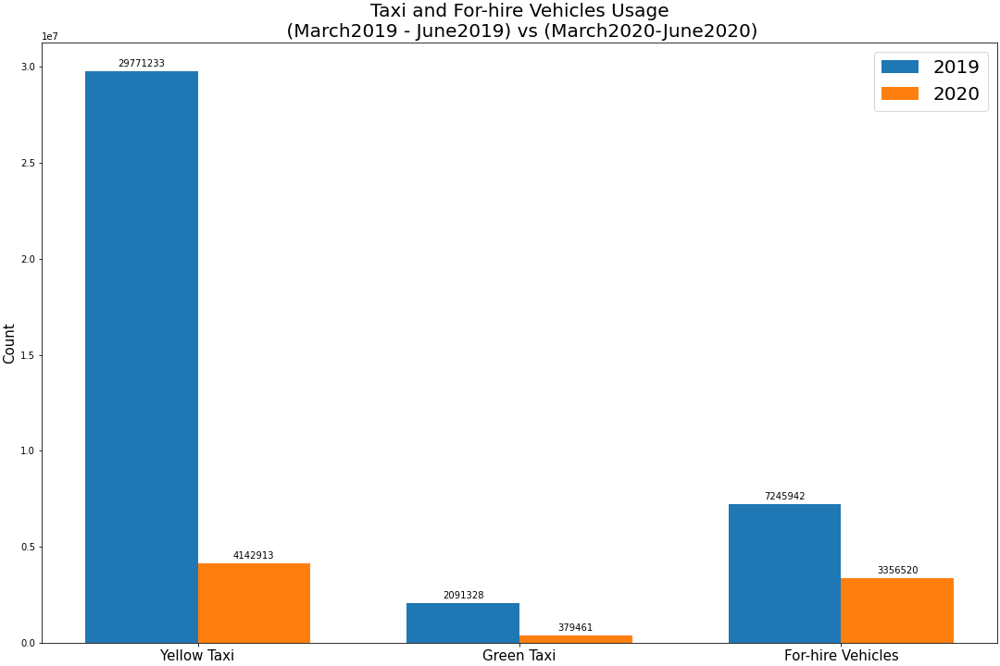

Slide 13
Usage by Borough:
Focal Point : Yellow Taxi
Used the most in Manhattan
86% decrease in use in Manhattan
88% decrease in use in Queens
(fyi: highest case counts in Queens)

Slide 14
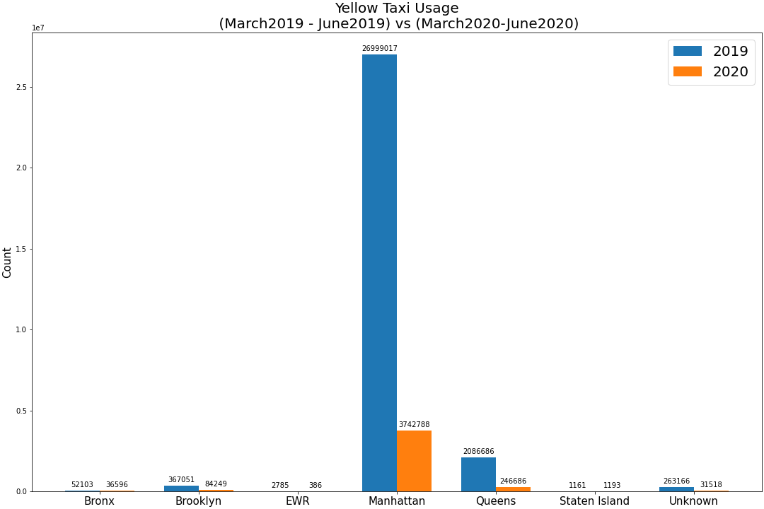

Slide 15
Citibike Usage

Slide 16
Citibike Data
Data sources:
https://s3.amazonaws.com/tripdata/index.html
Focal Point:
Number of trips by month
(March – June 2019) vs (March – June 2020)

Slide 17
Citibike vs Covid
We wanted to compare the impact Covid19 had on the usage of Citibikes in NYC
We compared March – June 2020
Our Questions for this segment are
- How did Covid 19/Coronavirus affect the usage of citibikes?
-

Slide 18
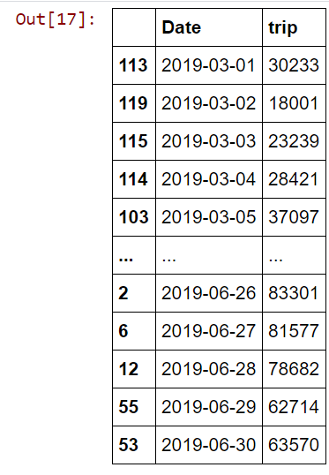
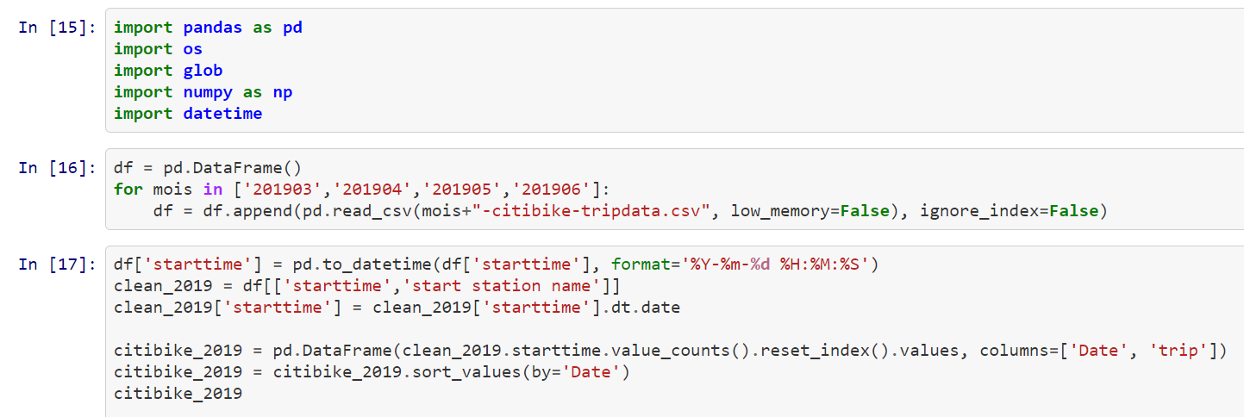
Citibike Usage <March – June 2019>

Slide 19
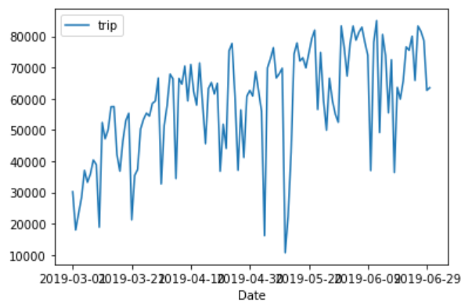
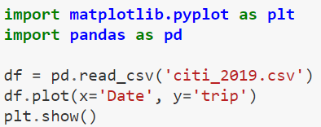
Citibike Usage Graph <March – June 2019>

Slide 20

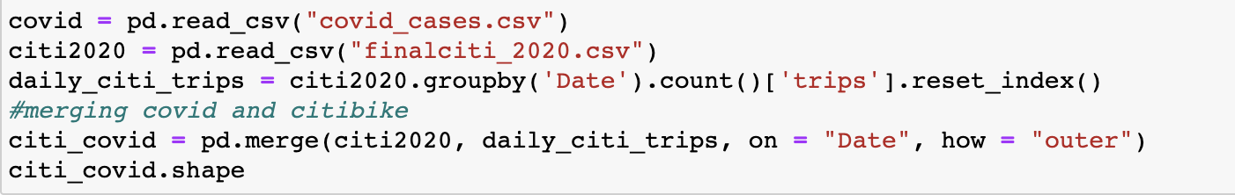
Citibike Usage <March – June 2020>: Cleaning

Slide 21
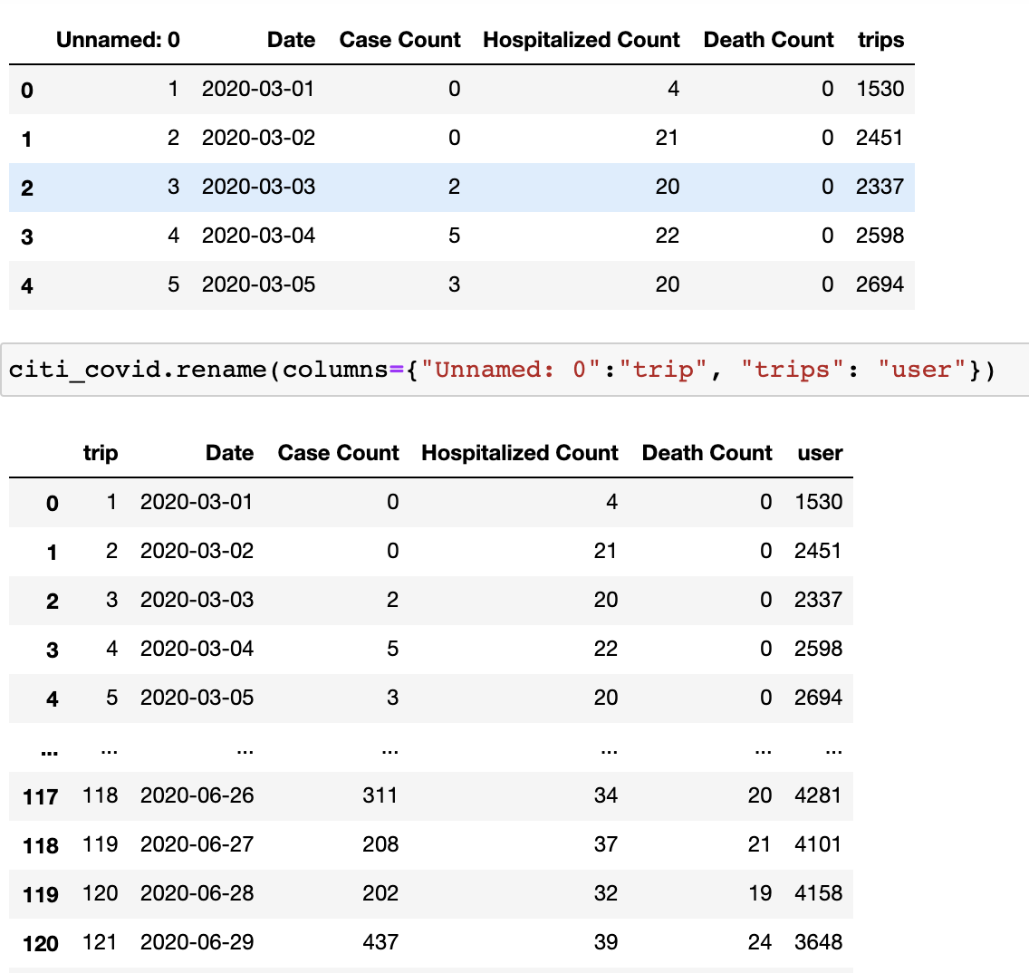
Citibike Usage <March – June 2020>: Cleaning

Slide 22
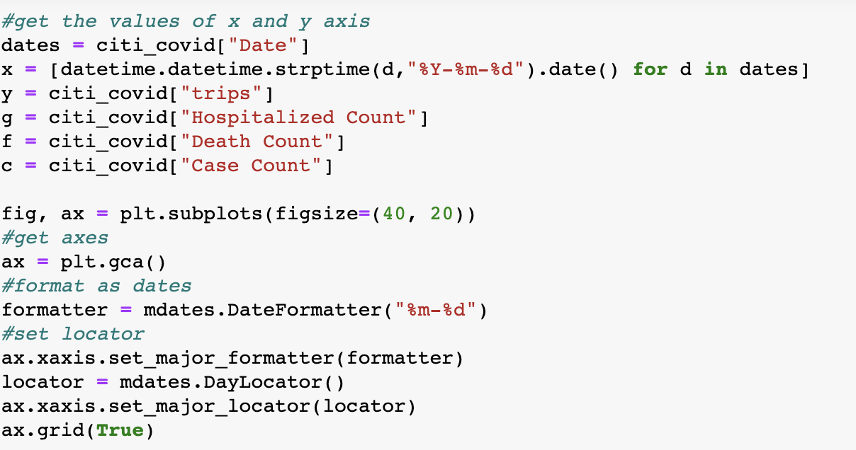
Citibike Usage <March – June 2020>: Cleaning

Slide 23
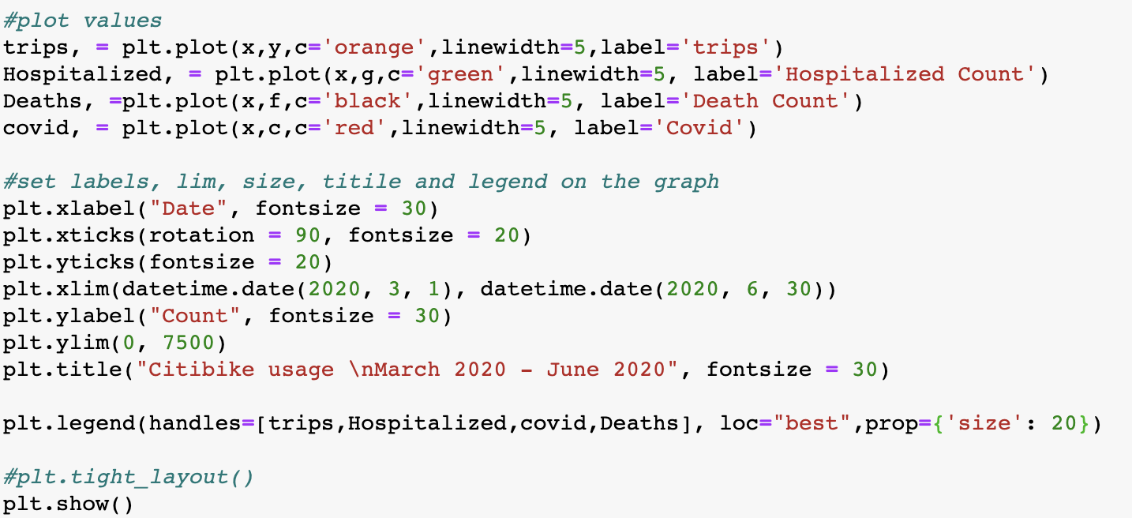
Citibike Usage <March – June 2020>: Cleaning

Slide 24
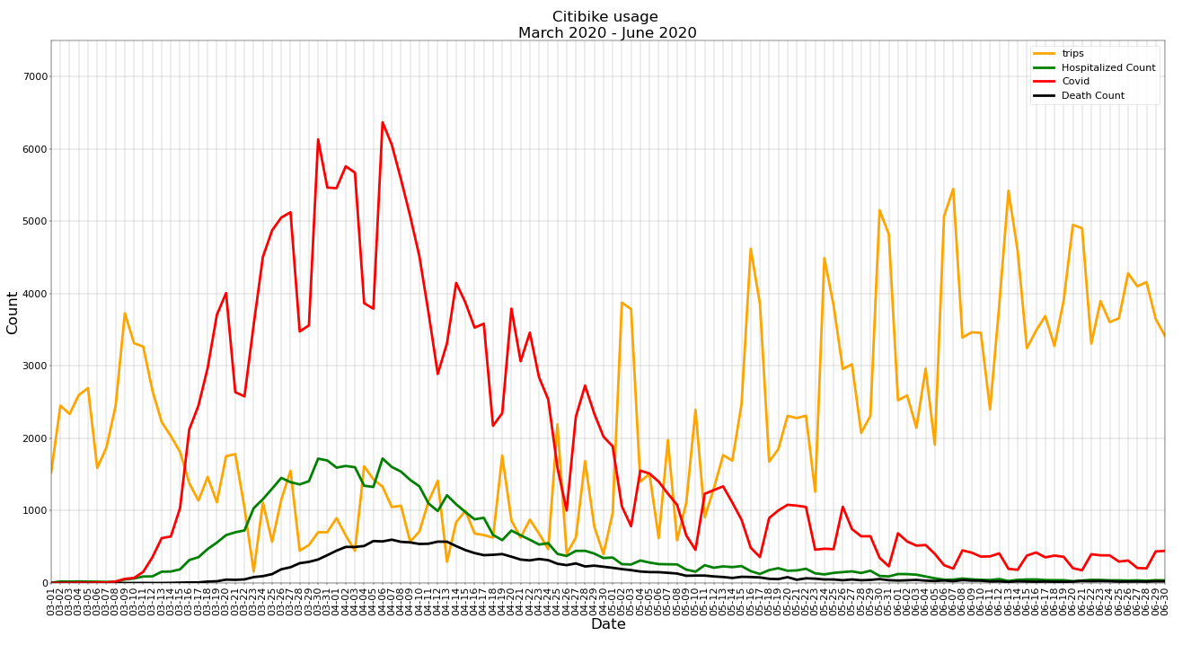

Slide 25
Subway Usage

Slide 26
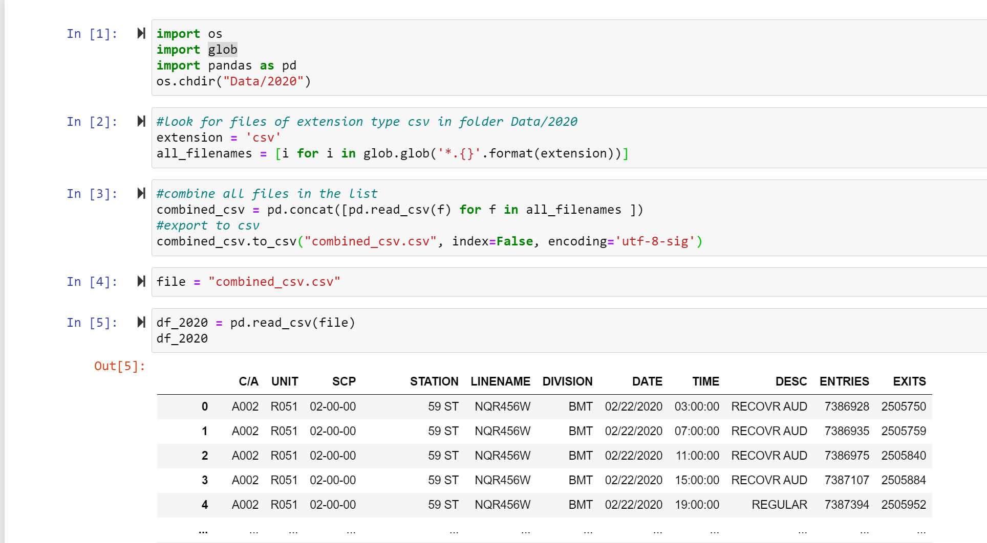
Subway Usage: Cleaning

Slide 27
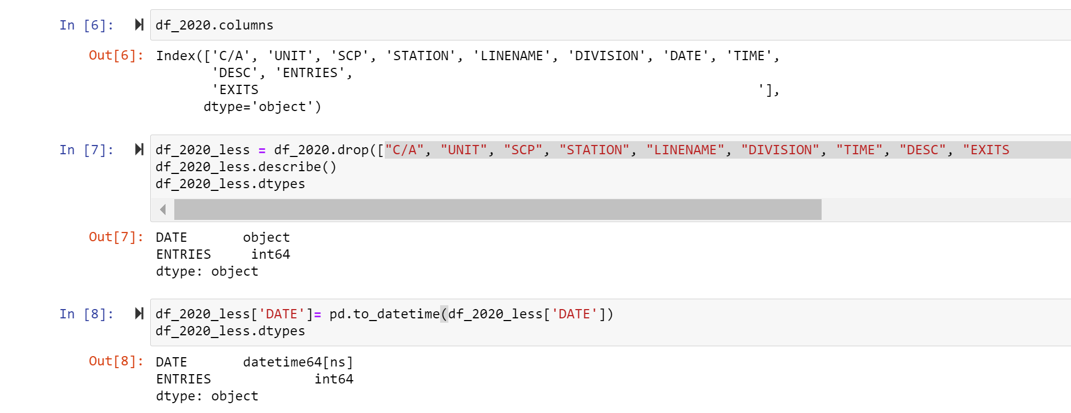
Subway Usage: Cleaning

Slide 28
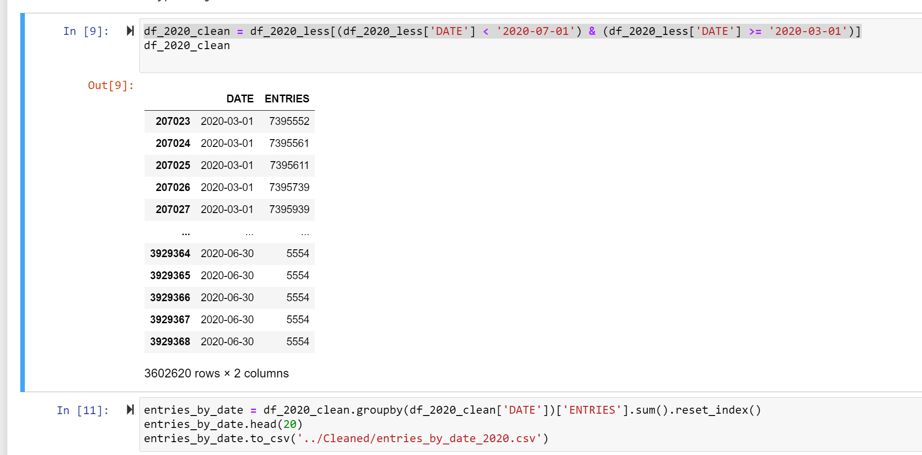
Subway Usage: Cleaning

Slide 29

Questions
Did citibike usage increase/decrease due to the several phases in NYC?

